Slide 1
Jehoshaphat – 2 Chronicles 19 & 20
PART 1:
Fully Prepared
Firmly Determined
Family United
PART 2:
Preparation Pays!

Slide 2
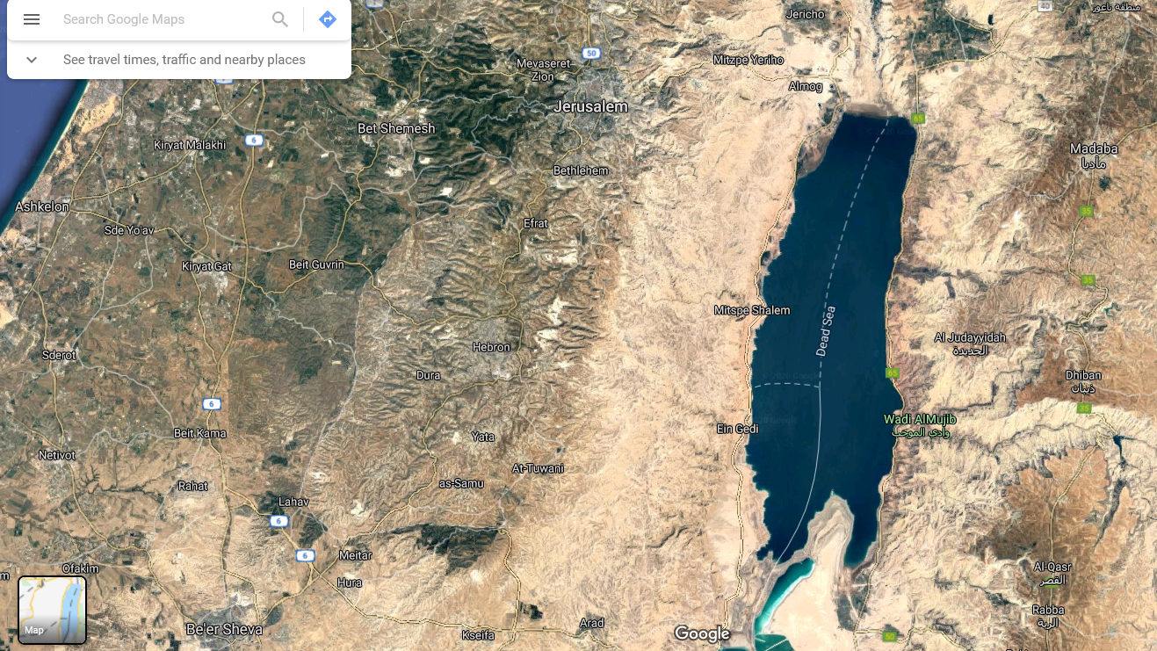
2 Chronicles 19
JERUSALEM
⁴ Jehoshaphat lived in Jerusalem, and he went out again among the people from Beersheba to the hill country of Ephraim and turned them back to the Lord, the God of their ancestors. ⁵ He appointed judges in the land…

Slide 3
2 Chronicles 19
JERUSALEM
⁴ Jehoshaphat lived in Jerusalem, and he went out again among the people from Beersheba to the hill country of Ephraim and turned them back to the Lord, the God of their ancestors. ⁵ He appointed judges in the land…
⁸ In Jerusalem also, Jehoshaphat appointed some of the Levites, priests and heads of Israelite families to administer the law of the Lord and to settle disputes. And they lived in Jerusalem. ⁹ He gave them these orders: ‘You must serve faithfully and wholeheartedly in the fear of the Lord.

Slide 4
2 Chronicles 20
JERUSALEM
AMMON
¹ After this, the Moabites and Ammonites with some of the Meunites came to wage war against Jehoshaphat.
MOAB

Slide 5
2 Chronicles 20
JERUSALEM
AMMON
¹ After this, the Moabites and Ammonites with some of the Meunites came to wage war against Jehoshaphat.
MOAB

Slide 6
2 Chronicles 20
JERUSALEM
AMMON
² Some people came and told Jehoshaphat, ‘A vast army is coming against you from Edom, from the other side of the Dead Sea. It is already in Hazezon Tamar’ (that is, En Gedi). ³ Alarmed, Jehoshaphat resolved to enquire of the Lord, and he proclaimed a fast for all Judah. ⁴ The people of Judah came together to seek help from the Lord; indeed, they came from every town in Judah to seek him.
EN GEDI
MOAB

Slide 7
2 Chronicles 20
JERUSALEM
AMMON
² Some people came and told Jehoshaphat, ‘A vast army is coming against you from Edom, from the other side of the Dead Sea. It is already in Hazezon Tamar’ (that is, En Gedi). ³ Alarmed, Jehoshaphat resolved to enquire of the Lord, and he proclaimed a fast for all Judah. ⁴ The people of Judah came together to seek help from the Lord; indeed, they came from every town in Judah to seek him.
EN GEDI
MOAB

Slide 8
2 Chronicles 20
² Some people came and told Jehoshaphat, ‘A vast army is coming against you from Edom, from the other side of the Dead Sea. It is already in Hazezon Tamar’ (that is, En Gedi). ³ Alarmed, Jehoshaphat resolved to enquire of the Lord, and he proclaimed a fast for all Judah. ⁴ The people of Judah came together to seek help from the Lord; indeed, they came from every town in Judah to seek him.

Slide 9
2 Chronicles 20
² Some people came and told Jehoshaphat, ‘A vast army is coming against you from Edom, from the other side of the Dead Sea. It is already in Hazezon Tamar’ (that is, En Gedi). ³ Alarmed, Jehoshaphat resolved to enquire of the Lord, and he proclaimed a fast for all Judah. ⁴ The people of Judah came together to seek help from the Lord; indeed, they came from every town in Judah to seek him.
NLT: “Terrified”

Slide 10
2 Chronicles 20
² Some people came and told Jehoshaphat, ‘A vast army is coming against you from Edom, from the other side of the Dead Sea. It is already in Hazezon Tamar’ (that is, En Gedi). ³ Alarmed, Jehoshaphat resolved to enquire of the Lord, and he proclaimed a fast for all Judah. ⁴ The people of Judah came together to seek help from the Lord; indeed, they came from every town in Judah to seek him.
Fully Prepared
Firmly Determined
You will seek me and find me when you seek me with all your heart.
Jeremiah 29:13

Slide 11
2 Chronicles 20
² Some people came and told Jehoshaphat, ‘A vast army is coming against you from Edom, from the other side of the Dead Sea. It is already in Hazezon Tamar’ (that is, En Gedi). ³ Alarmed, Jehoshaphat resolved to enquire of the Lord, and he proclaimed a fast for all Judah. ⁴ The people of Judah came together to seek help from the Lord; indeed, they came from every town in Judah to seek him.
Fully Prepared
Firmly Determined
Family United
When the Day of Pentecost had fully come, they were all with one accord in one place. Jeremiah 29:13

Slide 12
2 Chronicles 20
⁵ Then Jehoshaphat stood up in the assembly of Judah and Jerusalem at the temple of the Lord in the front of the new courtyard ⁶ and said [prayed]:
… ¹² We have no power to face this vast army that is attacking us. We do not know what to do, but our eyes are on you.’
¹³ All the men of Judah, with their wives and children and little ones, stood there before the Lord.

Slide 13
2 Chronicles 20
Family United
⁵ Then Jehoshaphat stood up in the assembly of Judah and Jerusalem at the temple of the Lord in the front of the new courtyard ⁶ and said [prayed]:
… ¹² We have no power to face this vast army that is attacking us. We do not know what to do, but our eyes are on you.’
¹³ All the men of Judah, with their wives and children and little ones, stood there before the Lord.

Slide 14
2 Chronicles 20
Firmly Determined
Family United
⁵ Then Jehoshaphat stood up in the assembly of Judah and Jerusalem at the temple of the Lord in the front of the new courtyard ⁶ and said [prayed]:
… ¹² We have no power to face this vast army that is attacking us. We do not know what to do, but our eyes are on you.’
¹³ All the men of Judah, with their wives and children and little ones, stood there before the Lord.

Slide 15
2 Chronicles 20
Fully Prepared
Firmly Determined
Family United
⁵ Then Jehoshaphat stood up in the assembly of Judah and Jerusalem at the temple of the Lord in the front of the new courtyard ⁶ and said [prayed]:
… ¹² We have no power to face this vast army that is attacking us. We do not know what to do, but our eyes are on you.’
¹³ All the men of Judah, with their wives and children and little ones, stood there before the Lord.
This had already started before the crisis:
⁸ In Jerusalem also, Jehoshaphat appointed some of the Levites, priests and heads of Israelite families to administer the law of the Lord and to settle disputes. And they lived in Jerusalem. ⁹ He gave them these orders: ‘You must serve faithfully and wholeheartedly in the fear of the Lord.’
(2 Chronicles 19:8-9)

Slide 16
2 Chronicles 20
Fully Prepared
Firmly Determined
Family United
⁵ Then Jehoshaphat stood up in the assembly of Judah and Jerusalem at the temple of the Lord in the front of the new courtyard ⁶ and said [prayed]:
… ¹² We have no power to face this vast army that is attacking us. We do not know what to do, but our eyes are on you.’
¹³ All the men of Judah, with their wives and children and little ones, stood there before the Lord.
To be continued…

Slide 17
2 Chronicles 20
Fully Prepared
Firmly Determined
Family United
Plot summary: Key actions:
God’s people turn back to him Repentance
The enemy attacks
God’s people seek him Prayer
God speaks
God’s people obey Obedience
God delivers them
God’s people worship him Worship

Slide 18
Prayer focus February 2020
Fully Prepared
Firmly Determined
Family United
Repentance
Prayer
Obedience
Worship
²³ Search me, God, and know my heart; test me and know my anxious thoughts. ²⁴ See if there is any offensive way in me, and lead me in the way everlasting.
Prepare my heart

Slide 19
Jehoshaphat – 2 Chronicles 19 & 20
PART 1:
Fully Prepared
Firmly Determined
Family United
PART 2:
Preparation Pays!

