Slide 1
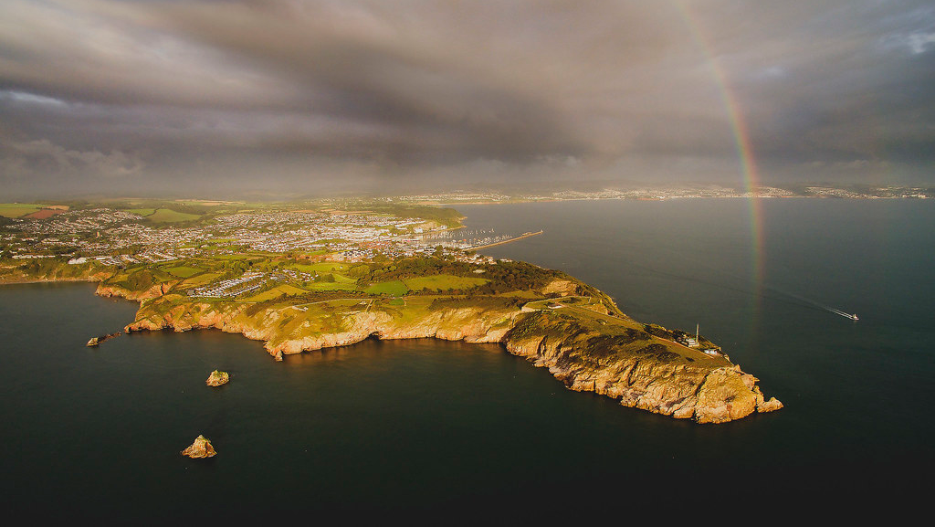
Rise and shine!
Isaiah 60:1-5

Slide 2
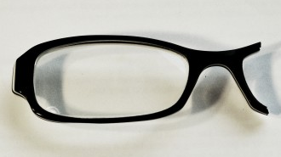

Slide 3
Old Testament Prophecy

Slide 4
Old Testament Prophecy
Ultimate
Intermediate
Immediate

Slide 5
Old Testament Prophecy
Ultimate
Intermediate
Immediate

Slide 6
Old Testament Prophecy
Ultimate
Intermediate
Immediate

Slide 7
Isaiah 60 and the Glory of the Lord
Ultimate
Intermediate
Immediate

Slide 8
Isaiah 60:1
‘Arise, shine, for your light has come,
and the glory of the Lord rises upon you.

Slide 9
Ephesians 5:1-14
¹ Follow God’s example, therefore, as dearly loved children ² and live a life of love, just as Christ loved us and gave himself up for us as a fragrant offering and sacrifice to God.

Slide 10
Ephesians 5:1-14
³ But among you there must not be even a hint of sexual immorality, or of any kind of impurity, or of greed, because these are improper for God’s holy people. ⁴ Nor should there be obscenity, foolish talk or coarse joking, which are out of place, but rather thanksgiving.

Slide 11
Ephesians 5:1-14
⁵ For of this you can be sure: no immoral, impure or greedy person – such a person is an idolater – has any inheritance in the kingdom of Christ and of God. ⁶ Let no one deceive you with empty words, for because of such things God’s wrath comes on those who are disobedient. ⁷ Therefore do not be partners with them.

Slide 12
Ephesians 5:1-14
⁸ For you were once darkness, but now you are light in the Lord. Live as children of light ⁹ (for the fruit of the light consists in all goodness, righteousness and truth) ¹⁰ and find out what pleases the Lord.

Slide 13
Ephesians 5:1-14
¹¹ Have nothing to do with the fruitless deeds of darkness, but rather expose them. ¹² It is shameful even to mention what the disobedient do in secret.

Slide 14
Ephesians 5:1-14
¹³ But everything exposed by the light becomes visible – and everything that is illuminated becomes a light. ¹⁴ This is why it is said:
‘Wake up, sleeper,
rise from the dead,
and Christ will shine on you.’

Slide 15
Isaiah 60:1
‘Arise, shine, for your light has come,
and the glory of the Lord rises upon you.

Slide 16
Isaiah 60:2
See, darkness covers the earth
and thick darkness is over the peoples,
but the Lord rises upon you
and his glory appears over you.

Slide 17
Isaiah 59:9-10
Justice is far from us,
and righteousness does not reach us.
We look for light, but all is darkness;
for brightness, but we walk in deep shadows.
Like the blind we grope along the wall,
feeling our way like people without eyes.
At midday we stumble as if it were twilight;
among the strong, we are like the dead.

Slide 18
Isaiah 60:2
See, darkness covers the earth
and thick darkness is over the peoples,
but the Lord rises upon you
and his glory appears over you.

Slide 19
Isaiah 60:3
Nations will come to your light,
and kings to the brightness of your dawn.

Slide 20
Isaiah 60:4
‘Lift up your eyes and look about you:
all assemble and come to you;
your sons come from afar,
and your daughters are carried on the hip.

Slide 21
Isaiah 60:5
Then you will look and be radiant,
your heart will throb and swell with joy;
the wealth on the seas will be brought to you,
to you the riches of the nations will come.

Slide 22
Ephesians 5:1-14
Follow God’s example ... live a life of love ... Live as children of light (goodness, righteousness, truth) ... Find out what pleases the Lord ... Wake up!

Slide 23
Rise and shine!

