Slide 1
How does it feel to be chosen?

Slide 2
Sometimes we do the choosing

Slide 3
Previously

Slide 4
Previously
Balaam’s view on Israel:
“I see people who live apart and do not consider themselves one of the nations.”
Numbers 23:9

Slide 5
Previously
Jesus’ view of his disciples:
“I have chosen you out of the world”
John 15:19

Slide 6
Previously
Jesus’ view of his disciples:
“As you [the Father] sent me into the world, I have sent them [the disciples] into the world. For them I sanctify myself, that they too may be truly sanctified.”
John 17:18-19

Slide 7
Today

Slide 8
Stay & Obey … Sow & Grow
Today

Slide 9
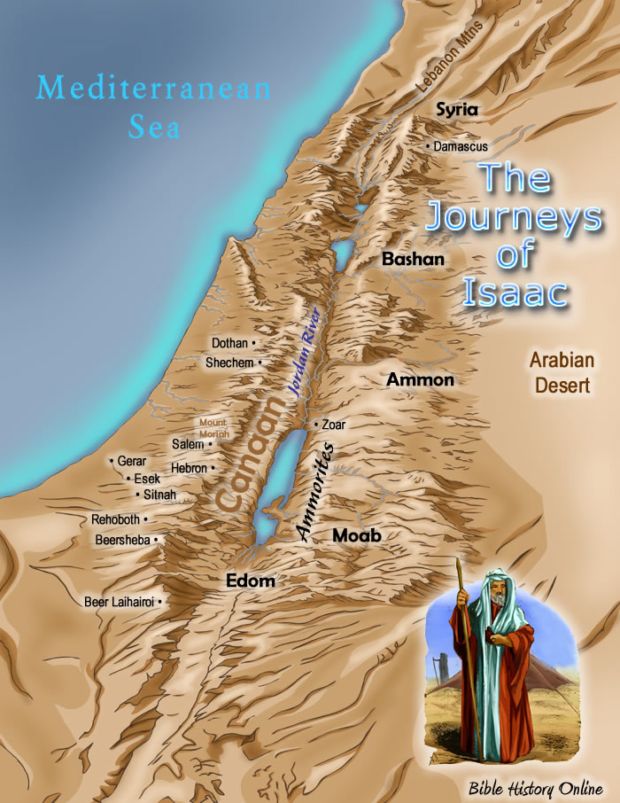
Stay & Obey … Sow & Grow
Isaac

Slide 10
Stay & Obey … Sow & Grow
Abraham
Isaac
Jacob
Esau
Joseph, etc

Slide 11
Stay & Obey … Sow & Grow
Genesis 25
Abraham dies
Jacob & Esau introduced
Esau sells his birthright
Abraham
Isaac
Jacob
Esau
Joseph, etc

Slide 12
Stay & Obey … Sow & Grow
Abraham
Hebron to Gerar (about 40 miles)
Isaac
Jacob
Esau
Genesis 26
¹ A severe famine now struck the land, as had happened before in Abraham’s time. So Isaac moved to Gerar, where Abimelech, king of the Philistines, lived.

Slide 13
Stay & Obey … Sow & Grow
Abraham
Isaac
Jacob
Esau
Genesis 26
² The Lord appeared to Isaac and said, “Do not go down to Egypt, but do as I tell you.

Slide 14
Stay & Obey … Sow & Grow
Abraham
Isaac
Jacob
Esau
Genesis 26
³ Live here as a foreigner in this land, and I will be with you and bless you. I hereby confirm that I will give all these lands to you and your descendants, just as I solemnly promised Abraham, your father.

Slide 15
Stay & Obey … Sow & Grow
Abraham
Isaac
Jacob
Esau
Genesis 26
⁴ I will cause your descendants to become as numerous as the stars of the sky, and I will give them all these lands. And through your descendants all the nations of the earth will be blessed.

Slide 16
Stay & Obey … Sow & Grow
Abraham
Isaac
Jacob
Esau
Genesis 26
⁵ I will do this because Abraham listened to me and obeyed all my requirements, commands, decrees, and instructions.” ⁶ So Isaac stayed in Gerar.

Slide 17
Stay & Obey … Sow & Grow
Abraham
Isaac
Jacob
Esau
Genesis 26
⁵ I will do this because Abraham listened to me and obeyed all my requirements, commands, decrees, and instructions.” ⁶ So Isaac stayed in Gerar...

Slide 18
Stay & Obey … Sow & Grow
Abraham
Isaac
Jacob
Esau
Genesis 26
¹² When Isaac planted his crops that year, he harvested a hundred times more grain than he planted, for the Lord blessed him. ¹³ He became a very rich man, and his wealth continued to grow.

Slide 19
Stay & Obey … Sow & Grow
Abraham
Isaac
Jacob
Esau
Genesis 26
¹⁴ He acquired so many flocks of sheep and goats, herds of cattle, and servants that the Philistines became jealous of him.

Slide 20
Stay & Obey … Sow & Grow
Abraham
Isaac
Jacob
Esau
Genesis 26
¹⁵ So the Philistines filled up all of Isaac’s wells with dirt. These were the wells that had been dug by the servants of his father, Abraham.

Slide 21
Stay & Obey … Sow & Grow
Abraham
Isaac
Jacob
Esau
Genesis 26
¹⁶ Finally, Abimelech ordered Isaac to leave the country. “Go somewhere else,” he said, “for you have become too powerful for us.”

Slide 22
Stay & Obey … Sow & Grow
Abraham
Isaac
Jacob
Esau
Genesis 26
¹⁷ So Isaac moved away to the Gerar Valley, where he set up their tents and settled down.

Slide 23
Stay & Obey … Sow & Grow
Abraham
Isaac
Jacob
Esau
Genesis 26
¹⁸ He reopened the wells his father had dug, which the Philistines had filled in after Abraham’s death. Isaac also restored the names Abraham had given them.

Slide 24
Stay & Obey … Sow & Grow
Abraham
Isaac
Jacob
Esau
Genesis 26
¹⁹ Isaac’s servants also dug in the Gerar Valley and discovered a well of fresh water.

Slide 25
Stay & Obey … Sow & Grow
Abraham
Isaac
Jacob
Esau
Genesis 26
²⁰ But then the shepherds from Gerar came and claimed the spring. “This is our water,” they said, and they argued over it with Isaac’s herdsmen. So Isaac named the well Esek (which means “argument”).

Slide 26
Stay & Obey … Sow & Grow
Abraham
Isaac
Jacob
Esau
Genesis 26
²¹ Isaac’s men then dug another well, but again there was a dispute over it. So Isaac named it Sitnah (which means “hostility”).

Slide 27
Stay & Obey … Sow & Grow
Abraham
Isaac
Jacob
Esau
Genesis 26
²² Abandoning that one, Isaac moved on and dug another well. This time there was no dispute over it, so Isaac named the place Rehoboth (which means “open space”), for he said, “At last the Lord has created enough space for us to prosper in this land.”

Slide 28
Stay & Obey … Sow & Grow
Abraham
Isaac
Jacob
Esau
Genesis 26
²³ From there Isaac moved to Beersheba, ²⁴ where the Lord appeared to him on the night of his arrival. “I am the God of your father, Abraham,” he said.

Slide 29
Stay & Obey … Sow & Grow
Abraham
Isaac
Jacob
Esau
Genesis 26
“Do not be afraid, for I am with you and will bless you. I will multiply your descendants, and they will become a great nation. I will do this because of my promise to Abraham, my servant.”

Slide 30
Stay & Obey … Sow & Grow
Abraham
Isaac
Jacob
Esau
Genesis 26
²⁵ Then Isaac built an altar there and worshiped the Lord. He set up his camp at that place, and his servants dug another well.

Slide 31
Stay & Obey … Sow & Grow
Abraham
Isaac
Jacob
Esau
Genesis 26
²⁶ One day King Abimelech came from Gerar with his adviser, Ahuzzath, and also Phicol, his army commander. ²⁷ “Why have you come here?” Isaac asked. “You obviously hate me, since you kicked me off your land.”

Slide 32
Stay & Obey … Sow & Grow
Abraham
Isaac
Jacob
Esau
Genesis 26
²⁸ They replied, “We can plainly see that the Lord is with you. So we want to enter into a sworn treaty with you. Let’s make a covenant.

Slide 33
Stay & Obey … Sow & Grow
Abraham
Isaac
Jacob
Esau
Genesis 26
²⁹ Swear that you will not harm us, just as we have never troubled you. We have always treated you well, and we sent you away from us in peace. And now look how the Lord has blessed you!”

Slide 34
Stay & Obey … Sow & Grow
Abraham
Isaac
Jacob
Esau
Genesis 26
³⁰ So Isaac prepared a covenant feast to celebrate the treaty, and they ate and drank together. ³¹ Early the next morning, they each took a solemn oath not to interfere with each other. Then Isaac sent them home again, and they left him in peace.

Slide 35
Stay & Obey … Sow & Grow
Abraham
Isaac
Jacob
Esau
Genesis 26
³² That very day Isaac’s servants came and told him about a new well they had dug. “We’ve found water!” they exclaimed.

Slide 36
Stay & Obey … Sow & Grow
Abraham
Isaac
Jacob
Esau
Genesis 26
³³ So Isaac named the well Shibah (which means “oath”). And to this day the town that grew up there is called Beersheba (which means “well of the oath”).

Slide 37
Stay & Obey … Sow & Grow
Abraham
Isaac
Jacob
Esau
Genesis 26
³⁴ At the age of forty, Esau married two Hittite wives: Judith, the daughter of Beeri, and Basemath, the daughter of Elon. ³⁵ But Esau’s wives made life miserable for Isaac and Rebekah.

Slide 38
Stay & Obey … Sow & Grow
Abraham
Genesis 24
² One day Abraham said to his oldest servant, the man in charge of his household... ³ ”Swear by the Lord, the God of heaven and earth, that you will not allow my son to marry one of these local Canaanite women.
Isaac
⁴ Go instead to my homeland, to my relatives, and find a wife there for my son Isaac.”
Genesis 26
³⁴ At the age of forty, Esau married two Hittite wives: Judith, the daughter of Beeri, and Basemath, the daughter of Elon. ³⁵ But Esau’s wives made life miserable for Isaac and Rebekah.

Slide 39
Stay & Obey … Sow & Grow
“I see people who live apart and do not consider themselves one of the nations.”
Numbers 23:9
“I have chosen you out of the world”
John 15:19
“As you sent me into the world, I have sent them into the world. For them I sanctify myself, that they too may be truly sanctified.”
John 17:18-19
“Live here as a foreigner in this land, and I will be with you and bless you.”
Genesis 26:3

