Slide 1
Confident conversations Talking with non believers
1: WHO ARE THESE PEOPLE?!

Slide 2
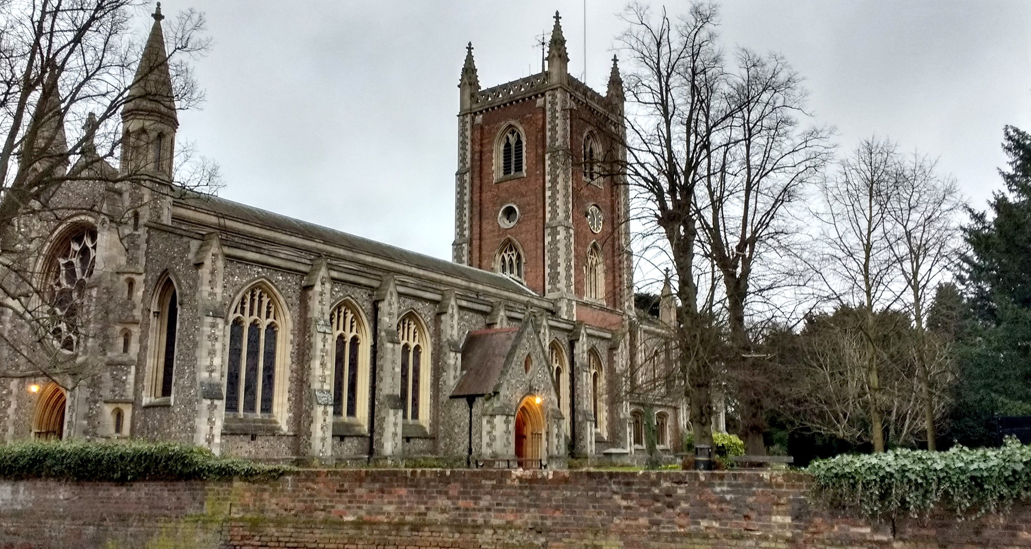
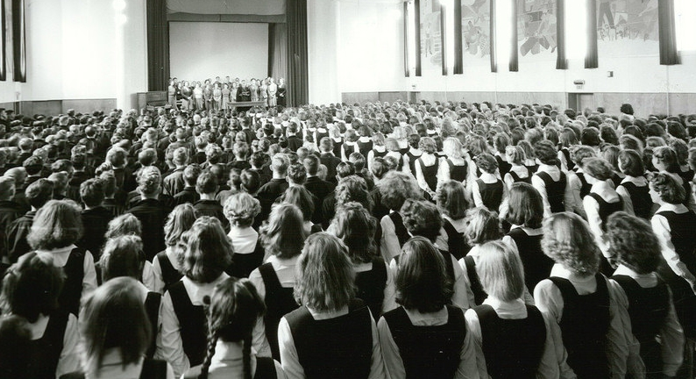
CONFIDENT CONVERSATIONS 1: Who are these people?!
Britain – “A Christian country”

Slide 3
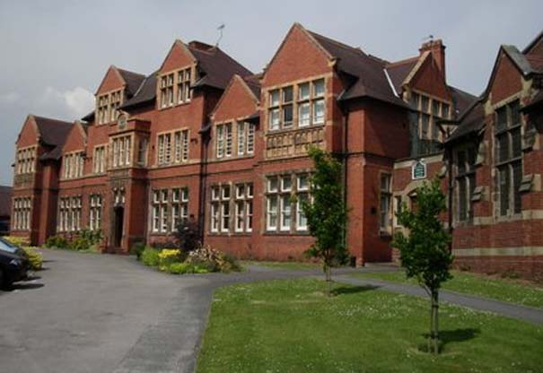
CONFIDENT CONVERSATIONS 1: Who are these people?!
A Sound Argument

Slide 4
CONFIDENT CONVERSATIONS 1: Who are these people?!
The battle is won in the air
“Do not be afraid or discouraged because of this vast army. For the battle is not yours, but God's.” (2 Chronicles 20:15)
“The weapons we fight with are not the weapons of the world. On the contrary, they have divine power to demolish strongholds.” (2 Corinthians 10:4)
“For our struggle is not against flesh and blood, but against the rulers, against the authorities, against the powers of this dark world and against the spiritual forces of evil in the heavenly realms.” (Ephesians 6:12)
“No one can come to me unless the Father who sent me draws them” (John 6:44)

Slide 5
CONFIDENT CONVERSATIONS 1: Who are these people?!
Yes the world is changing
But we have an unchanging message
And no one will receive that message without God’s help
So what do we do?

Slide 6
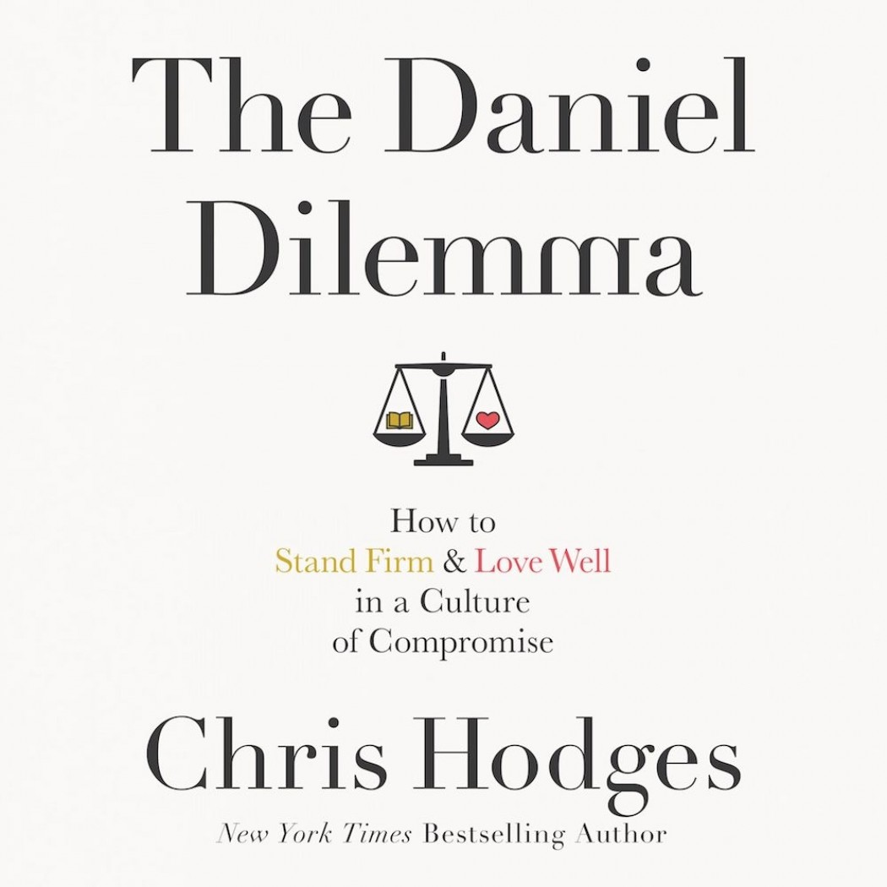
CONFIDENT CONVERSATIONS 1: Who are these people?!
Two choices: blend in or stand out

Slide 7
CONFIDENT CONVERSATIONS 1: Who are these people?!
Difficult Questions

Slide 8
CONFIDENT CONVERSATIONS 1: Who are these people?!
Ground Rules
1: The person is more important than their question
Jesus died to win people not arguments

Slide 9
CONFIDENT CONVERSATIONS 1: Who are these people?!
Ground Rules
2: The answer might be another question
Jesus asked more questions than he answered

Slide 10
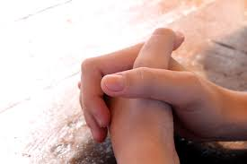
CONFIDENT CONVERSATIONS 1: Who are these people?!
Ground Rules
3: Prayer is paramount
“Apart from me you can do nothing”

Slide 11
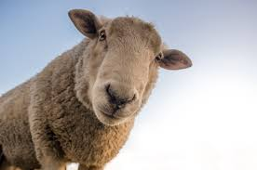
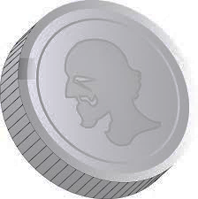
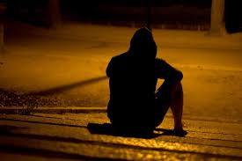
CONFIDENT CONVERSATIONS 1: Who are these people?!
Ground Rules
4: Unbelievers are seen as lost
Luke 15

Slide 12
CONFIDENT CONVERSATIONS 1: Who are these people?!
Ground Rules
5: Lost people are still of infinite worth
Rejoicing in heaven

Slide 13
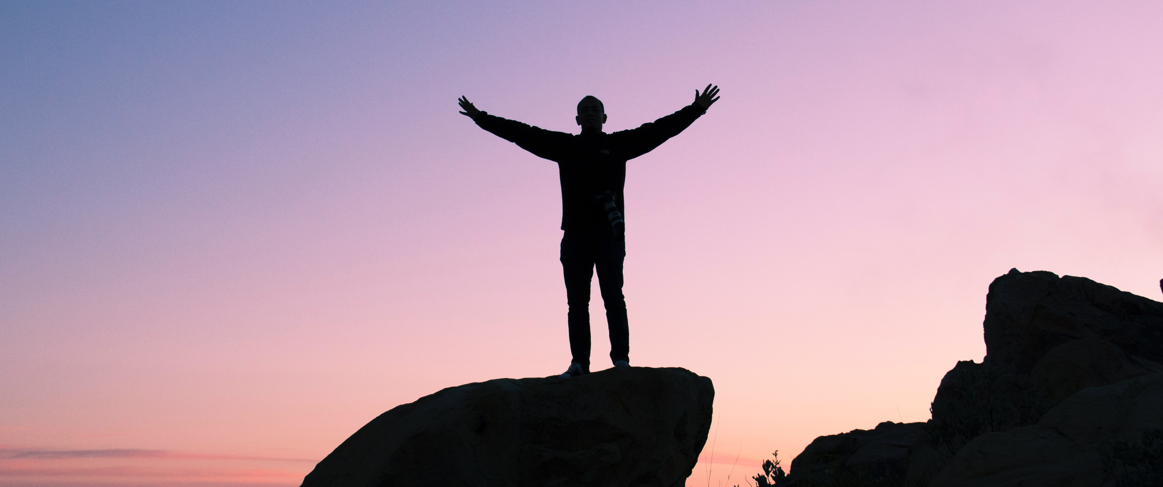
CONFIDENT CONVERSATIONS 1: Who are these people?!
Ground Rules
6: Lost people are lost, however it might seem.

Slide 14
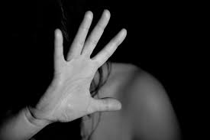
CONFIDENT CONVERSATIONS 1: Who are these people?!
Ground Rules
7: Lost people need help

Slide 15
CONFIDENT CONVERSATIONS 1: Who are these people?!
Who are these people?
People just like us.
People who need a saviour.
The world is changing but God is not.
The world is changing but people still have the same needs and questions.
Next time we will look at one of the top questions asked by non believers.

Slide 16
CONFIDENT CONVERSATIONS THE QUESTIONS
From my limited survey, these are the question areas:
Evil & Suffering
Science vs Faith
The Bible
Jesus the only way
The Church
Life after Death
Sexuality

